Slide 1
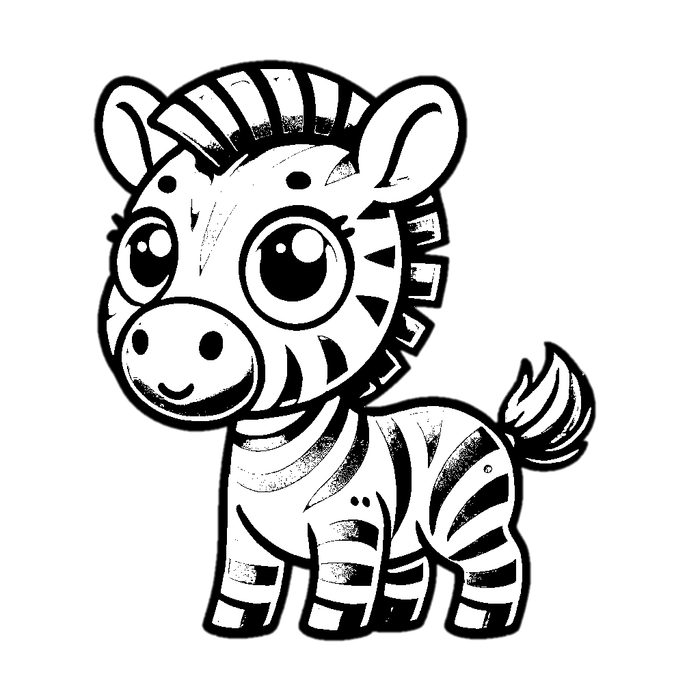
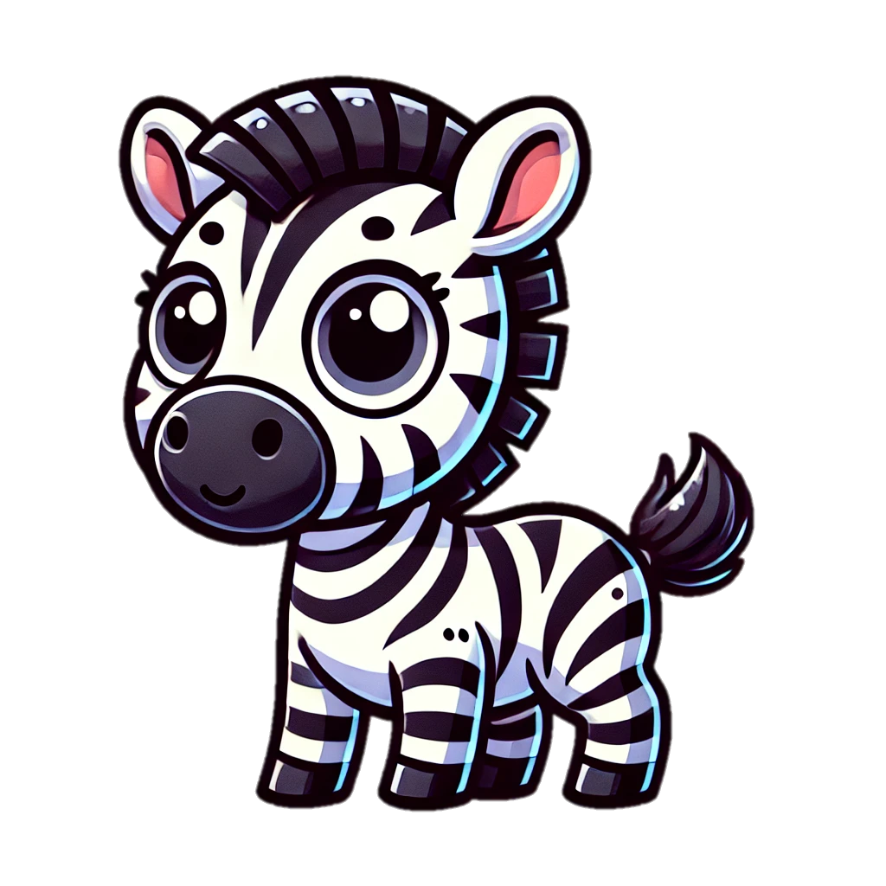
Trace & Color
Wild Animals
Zebra

Slide 2
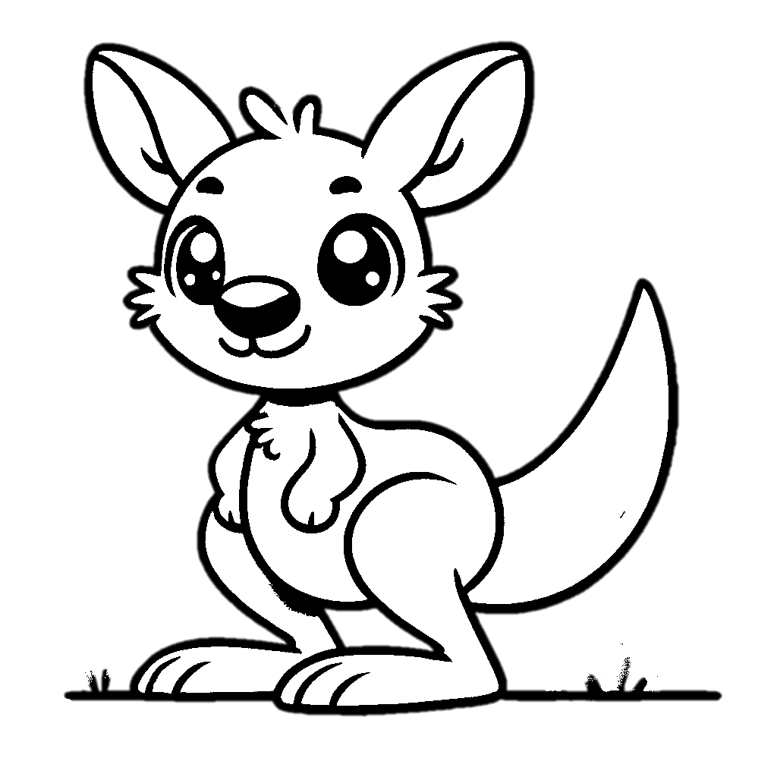
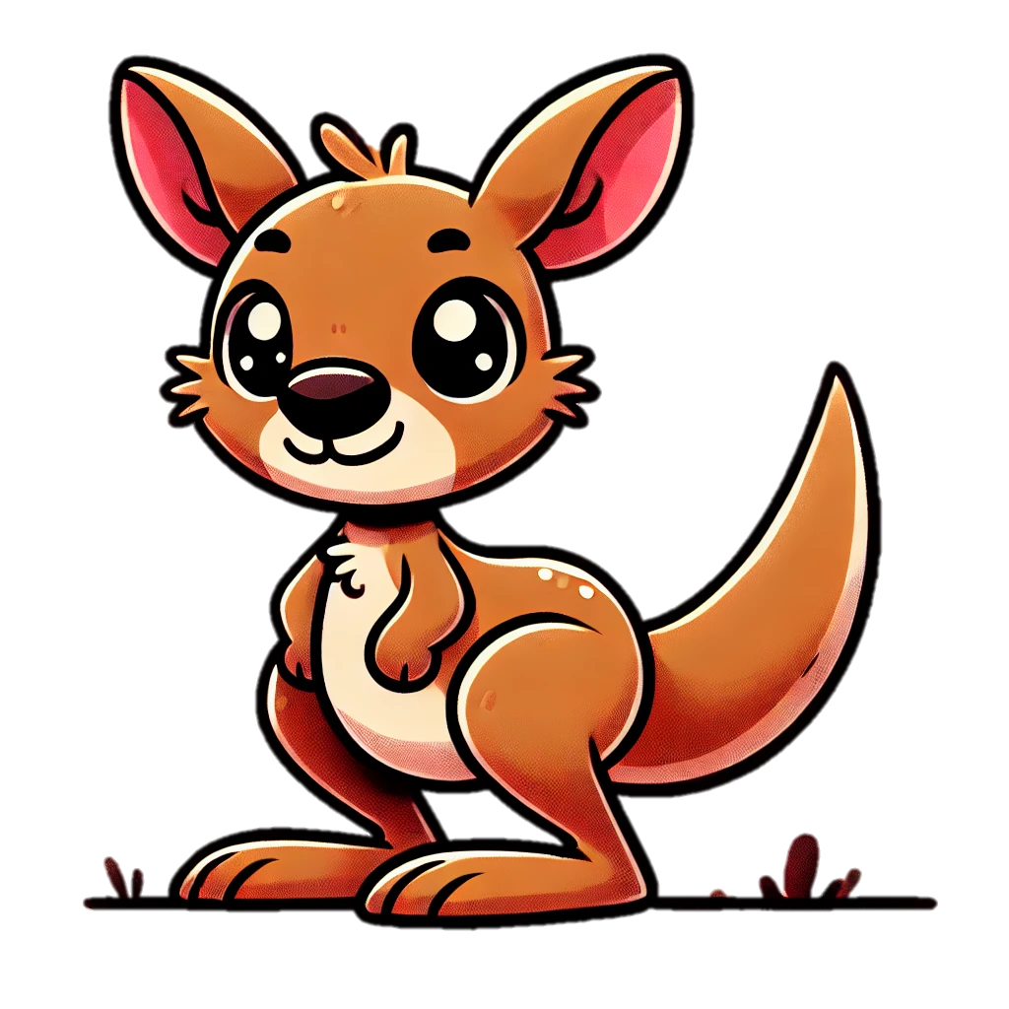
Trace & Color
Wild Animals
Kangaroo

Slide 3
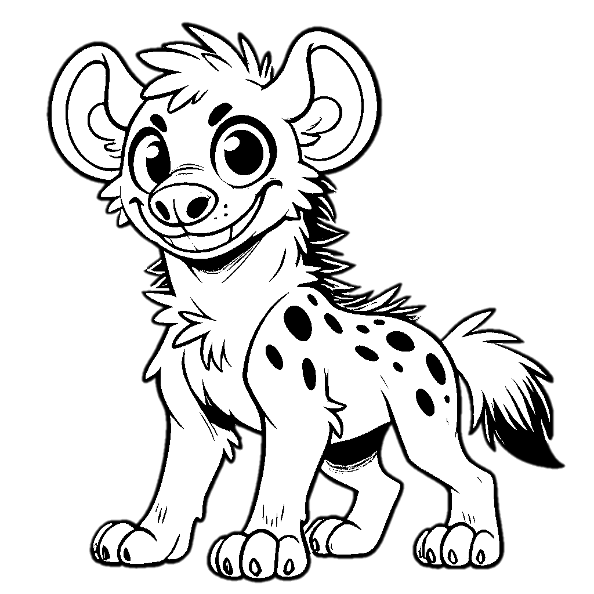
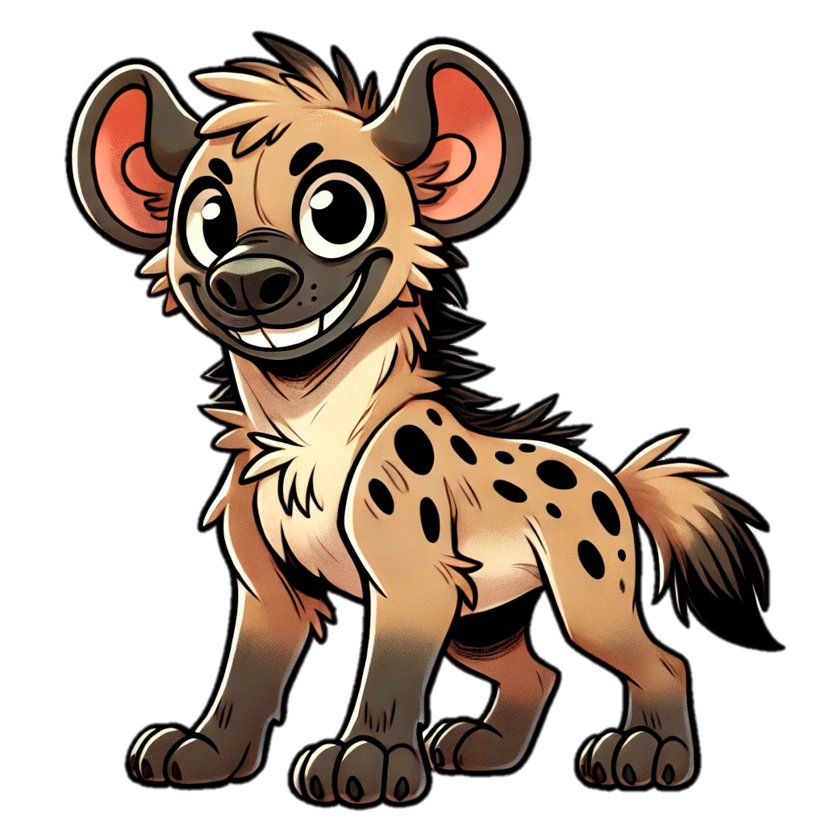
Trace & Color
Wild Animals
Hyena

Slide 4
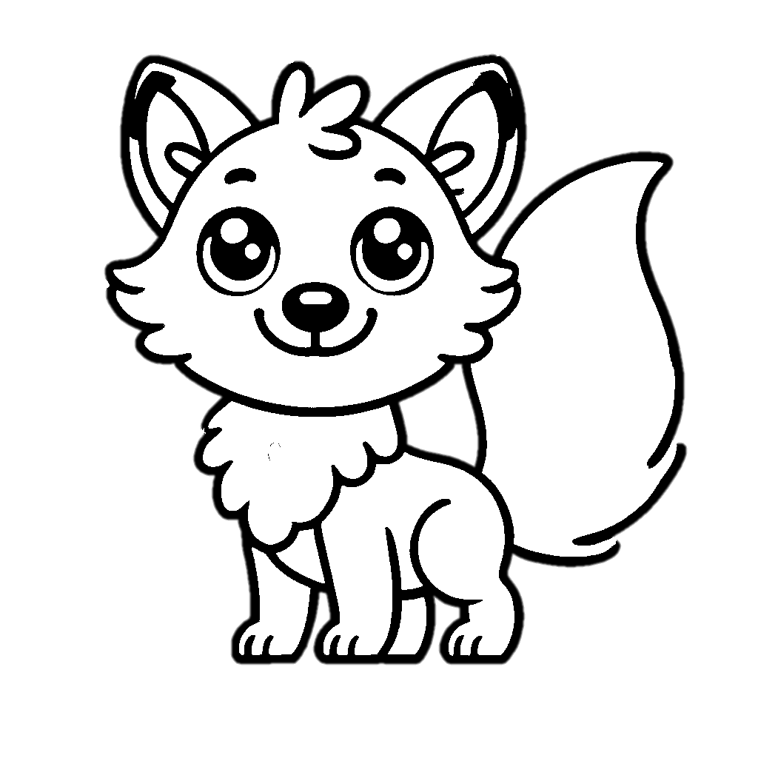

Trace & Color
Wild Animals
Fox

Slide 5
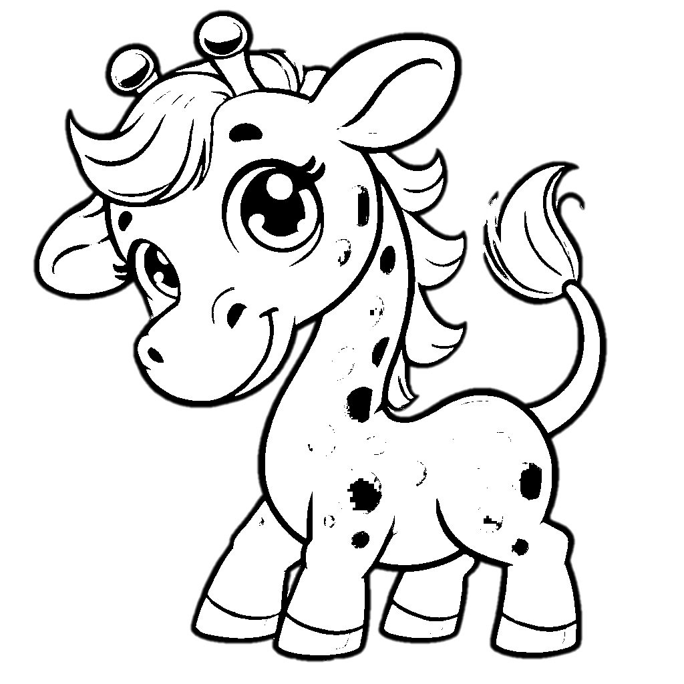
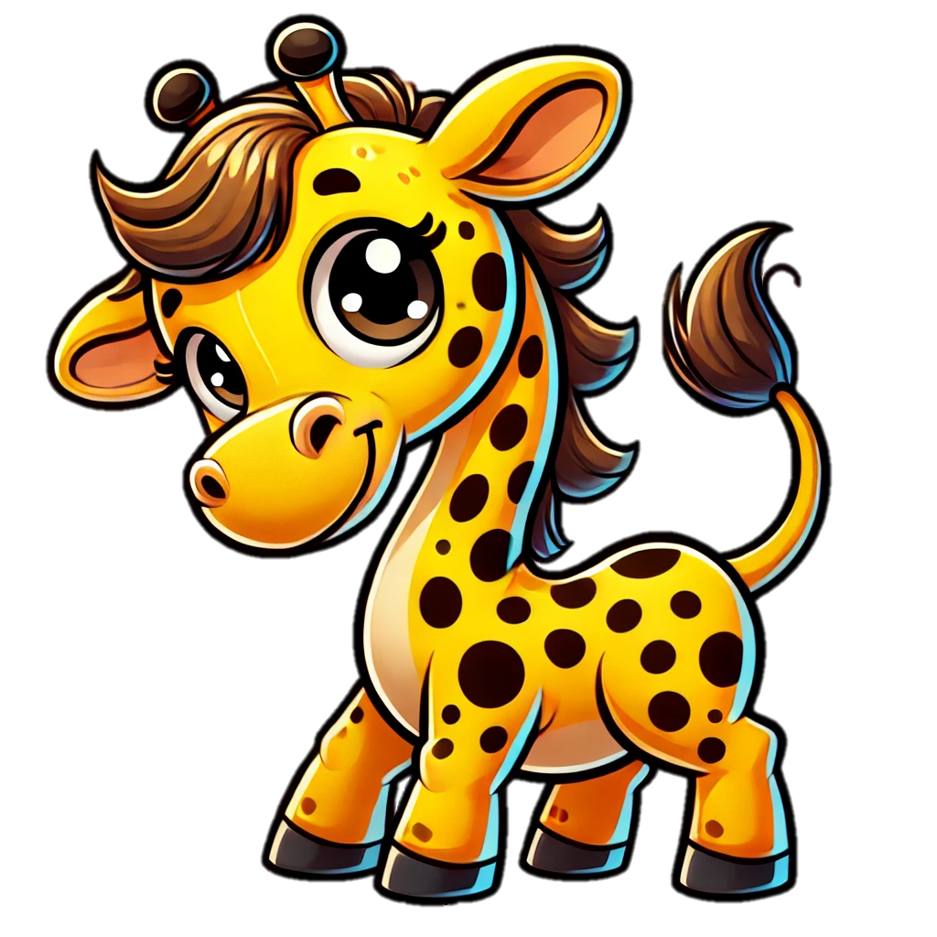
Trace & Color
Wild Animals
Giraffe

Slide 6


Trace & Color
Wild Animals
Monkey

Slide 7


Trace & Color
Wild Animals
Koala

Slide 8


Trace & Color
Wild Animals
Gorilla

Slide 9
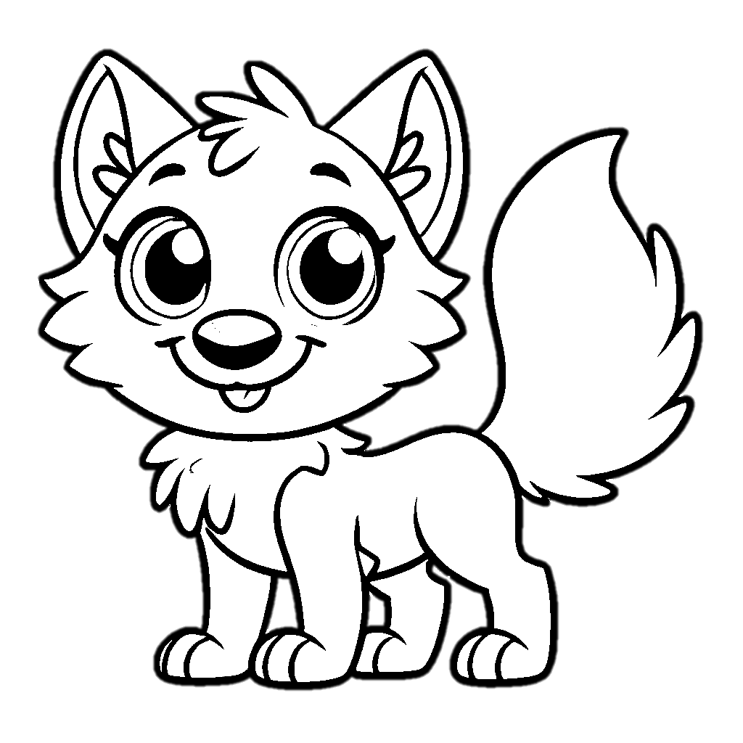

Trace & Color
Wild Animals
Wolf

Slide 10


Trace & Color
Wild Animals
Panda

Slide 11


Trace & Color
Wild Animals
Porcupine

Slide 12


Trace & Color
Wild Animals
Sloth

Slide 13
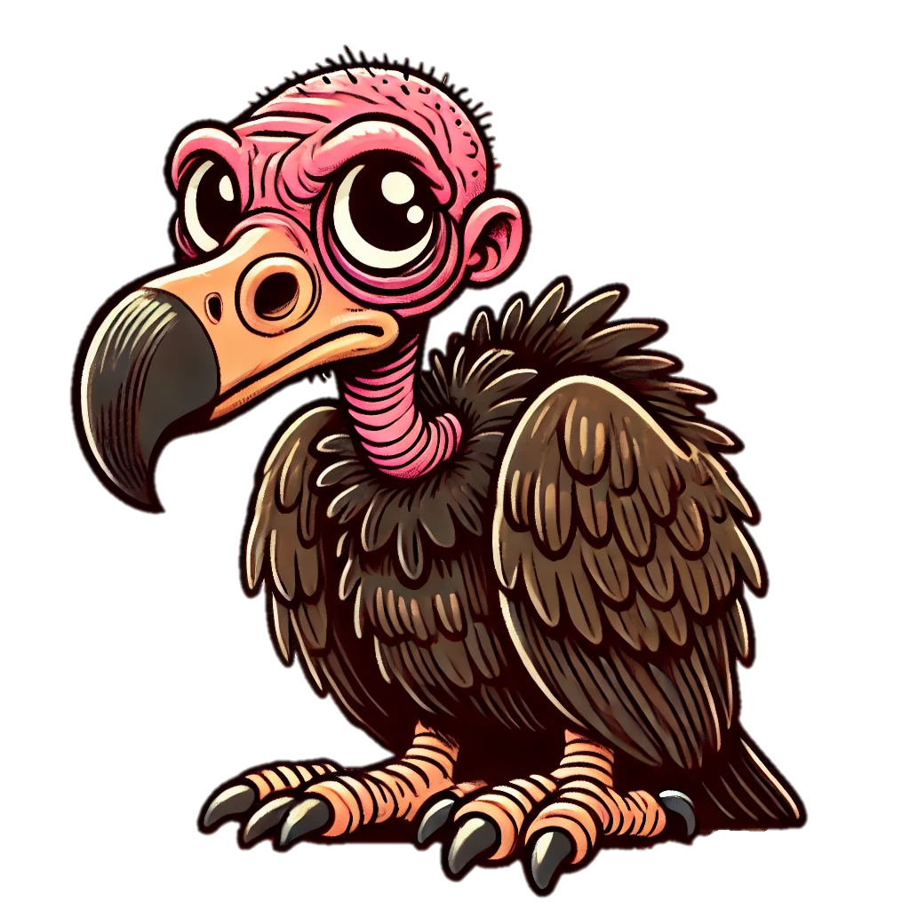
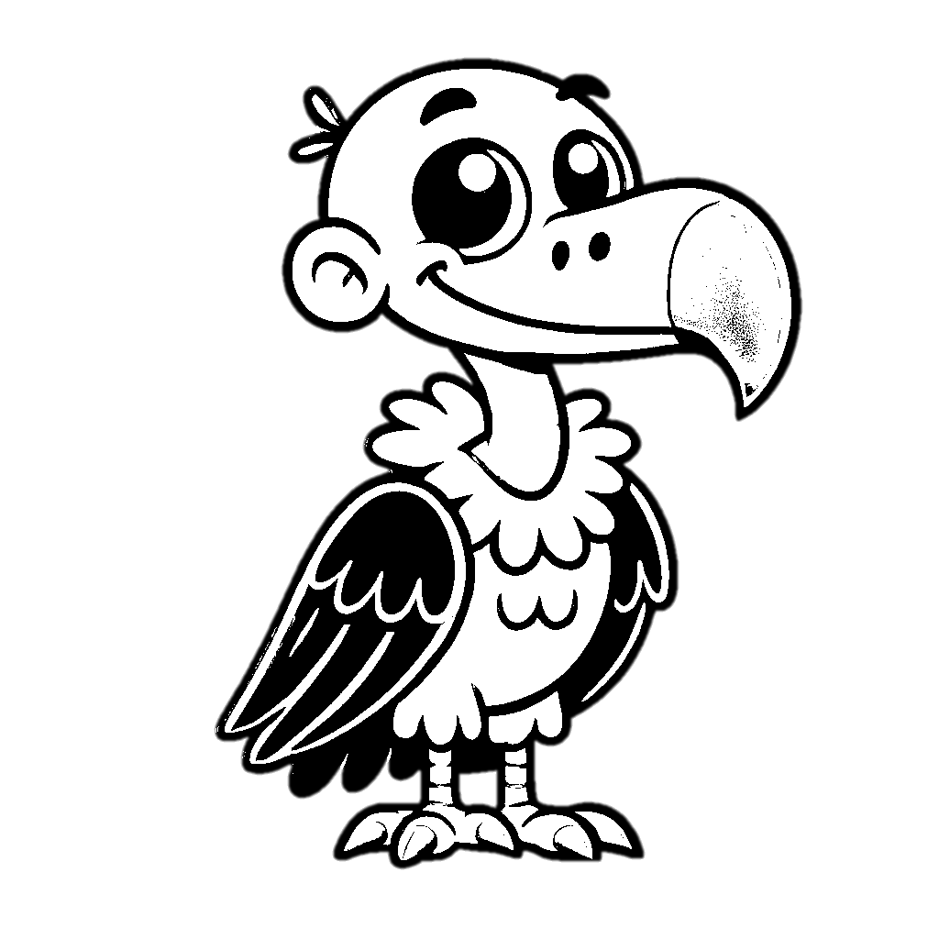
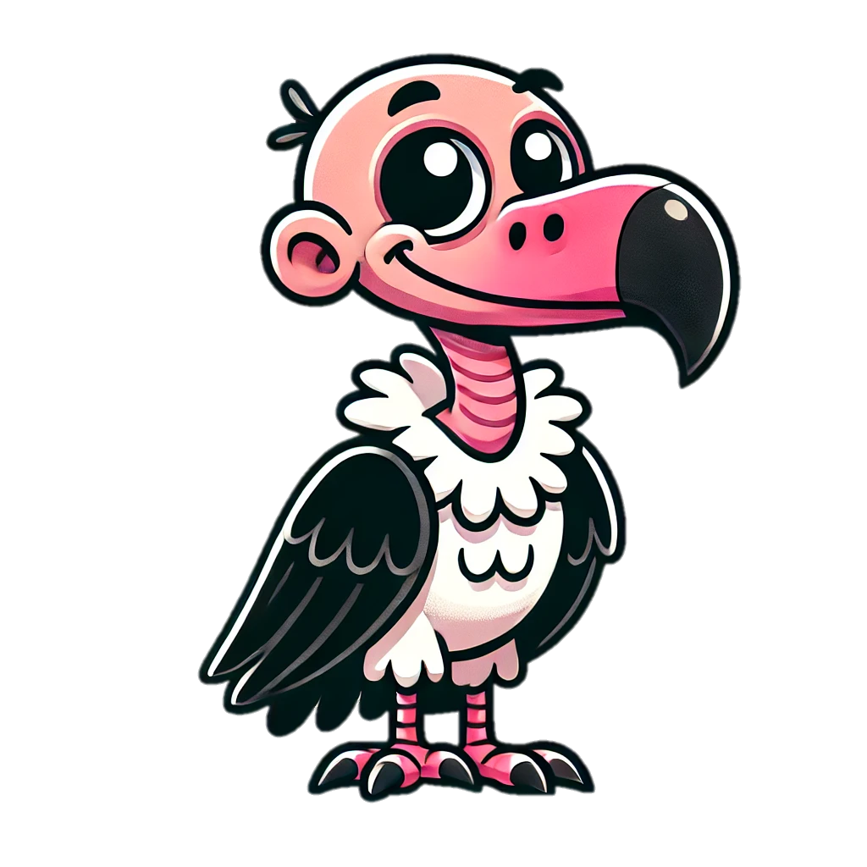
Trace & Color
Wild Animals
Vulture

Slide 14



Trace & Color
Wild Animals
Crocodile

